Slide 1
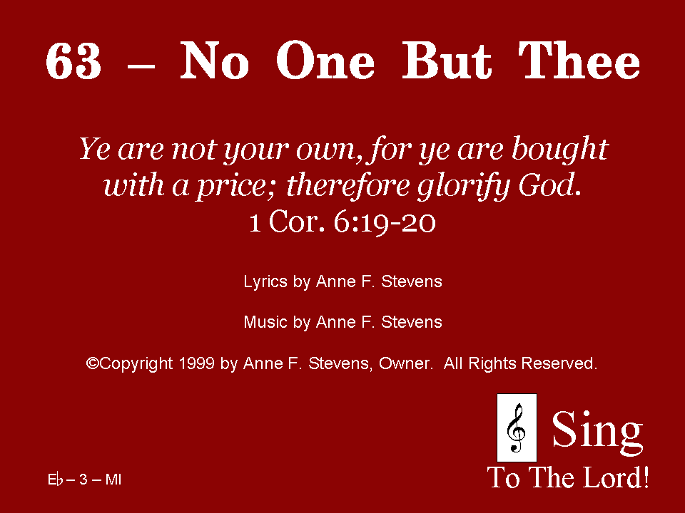
063 - No One But Thee - Title

Slide 2
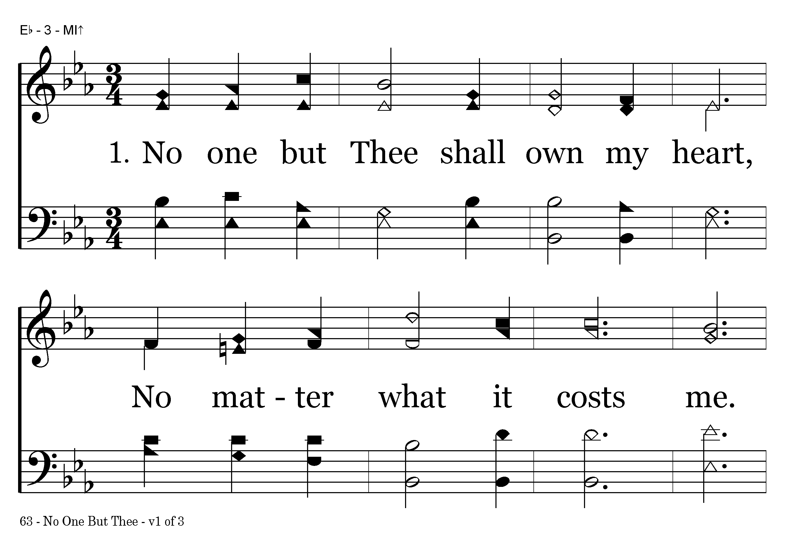
063 - No One But Thee - 1.1

Slide 3
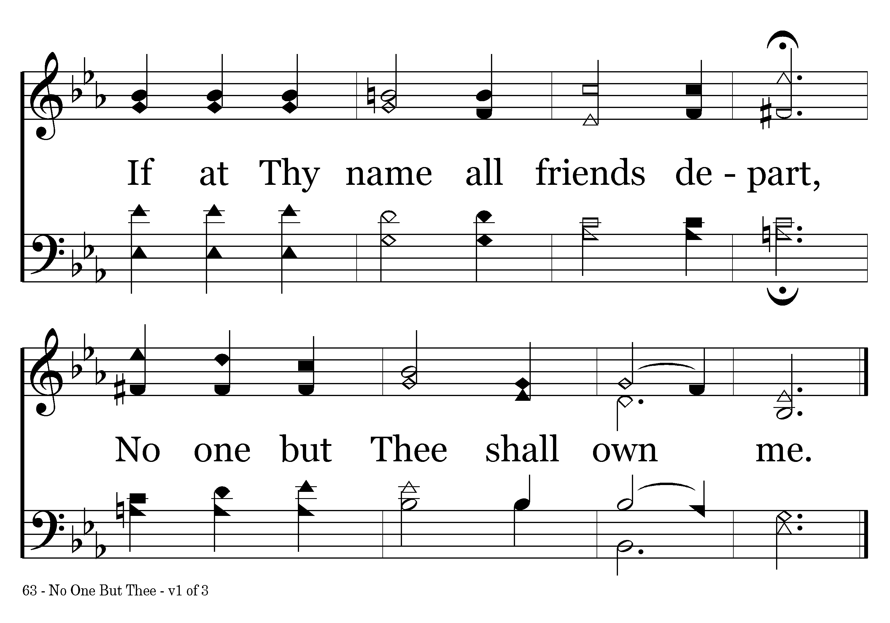
063 - No One But Thee - 1.2
End of Verse 1

Slide 4
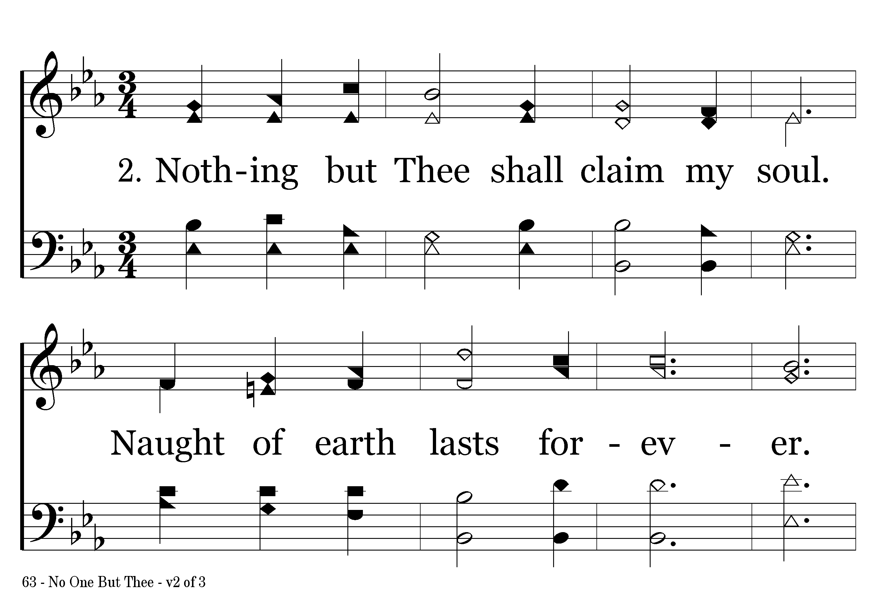
063 - No One But Thee - 2.1

Slide 5
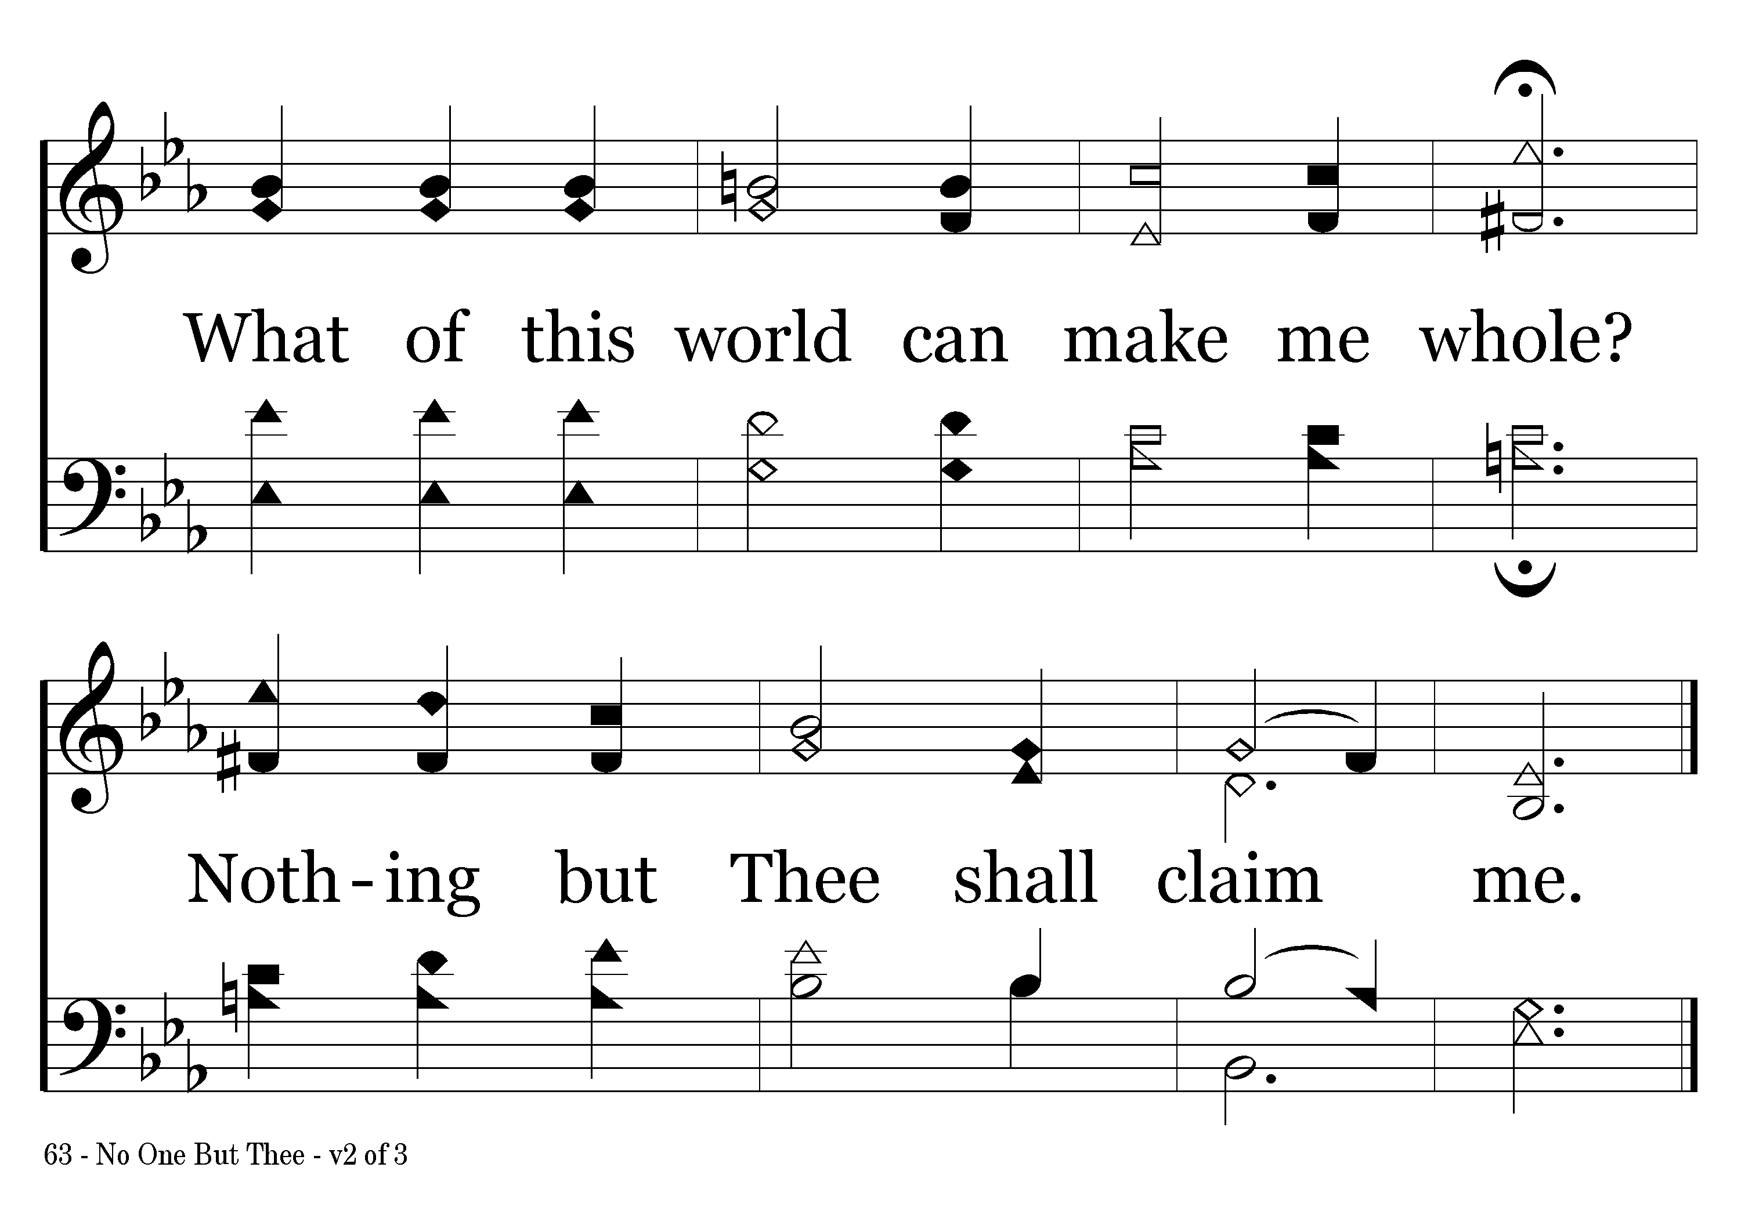
063 - No One But Thee - 2.2
End of Verse 2

Slide 6
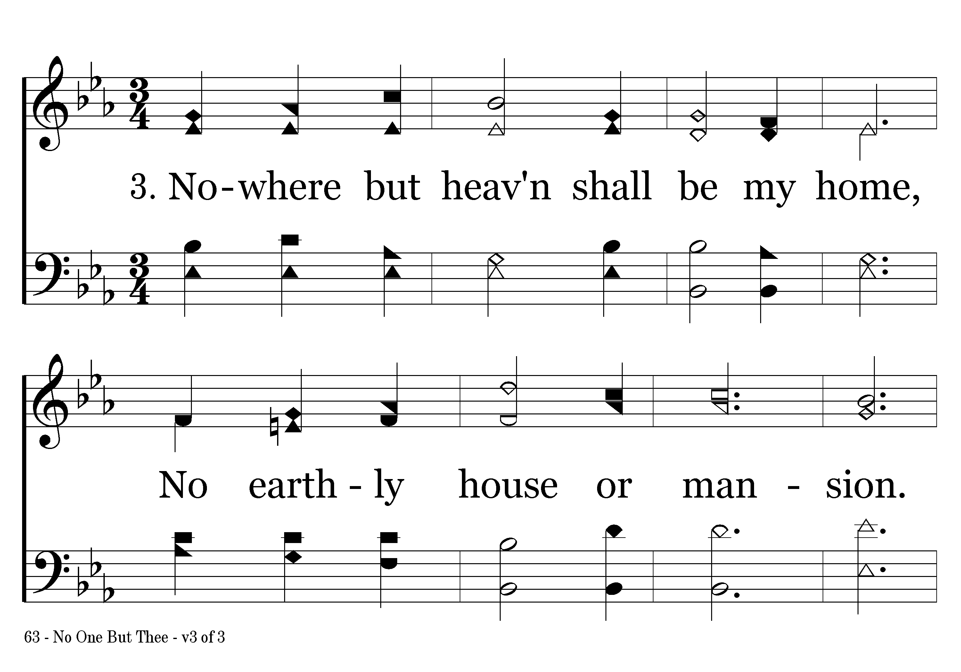
063 - No One But Thee - 3.1

Slide 7
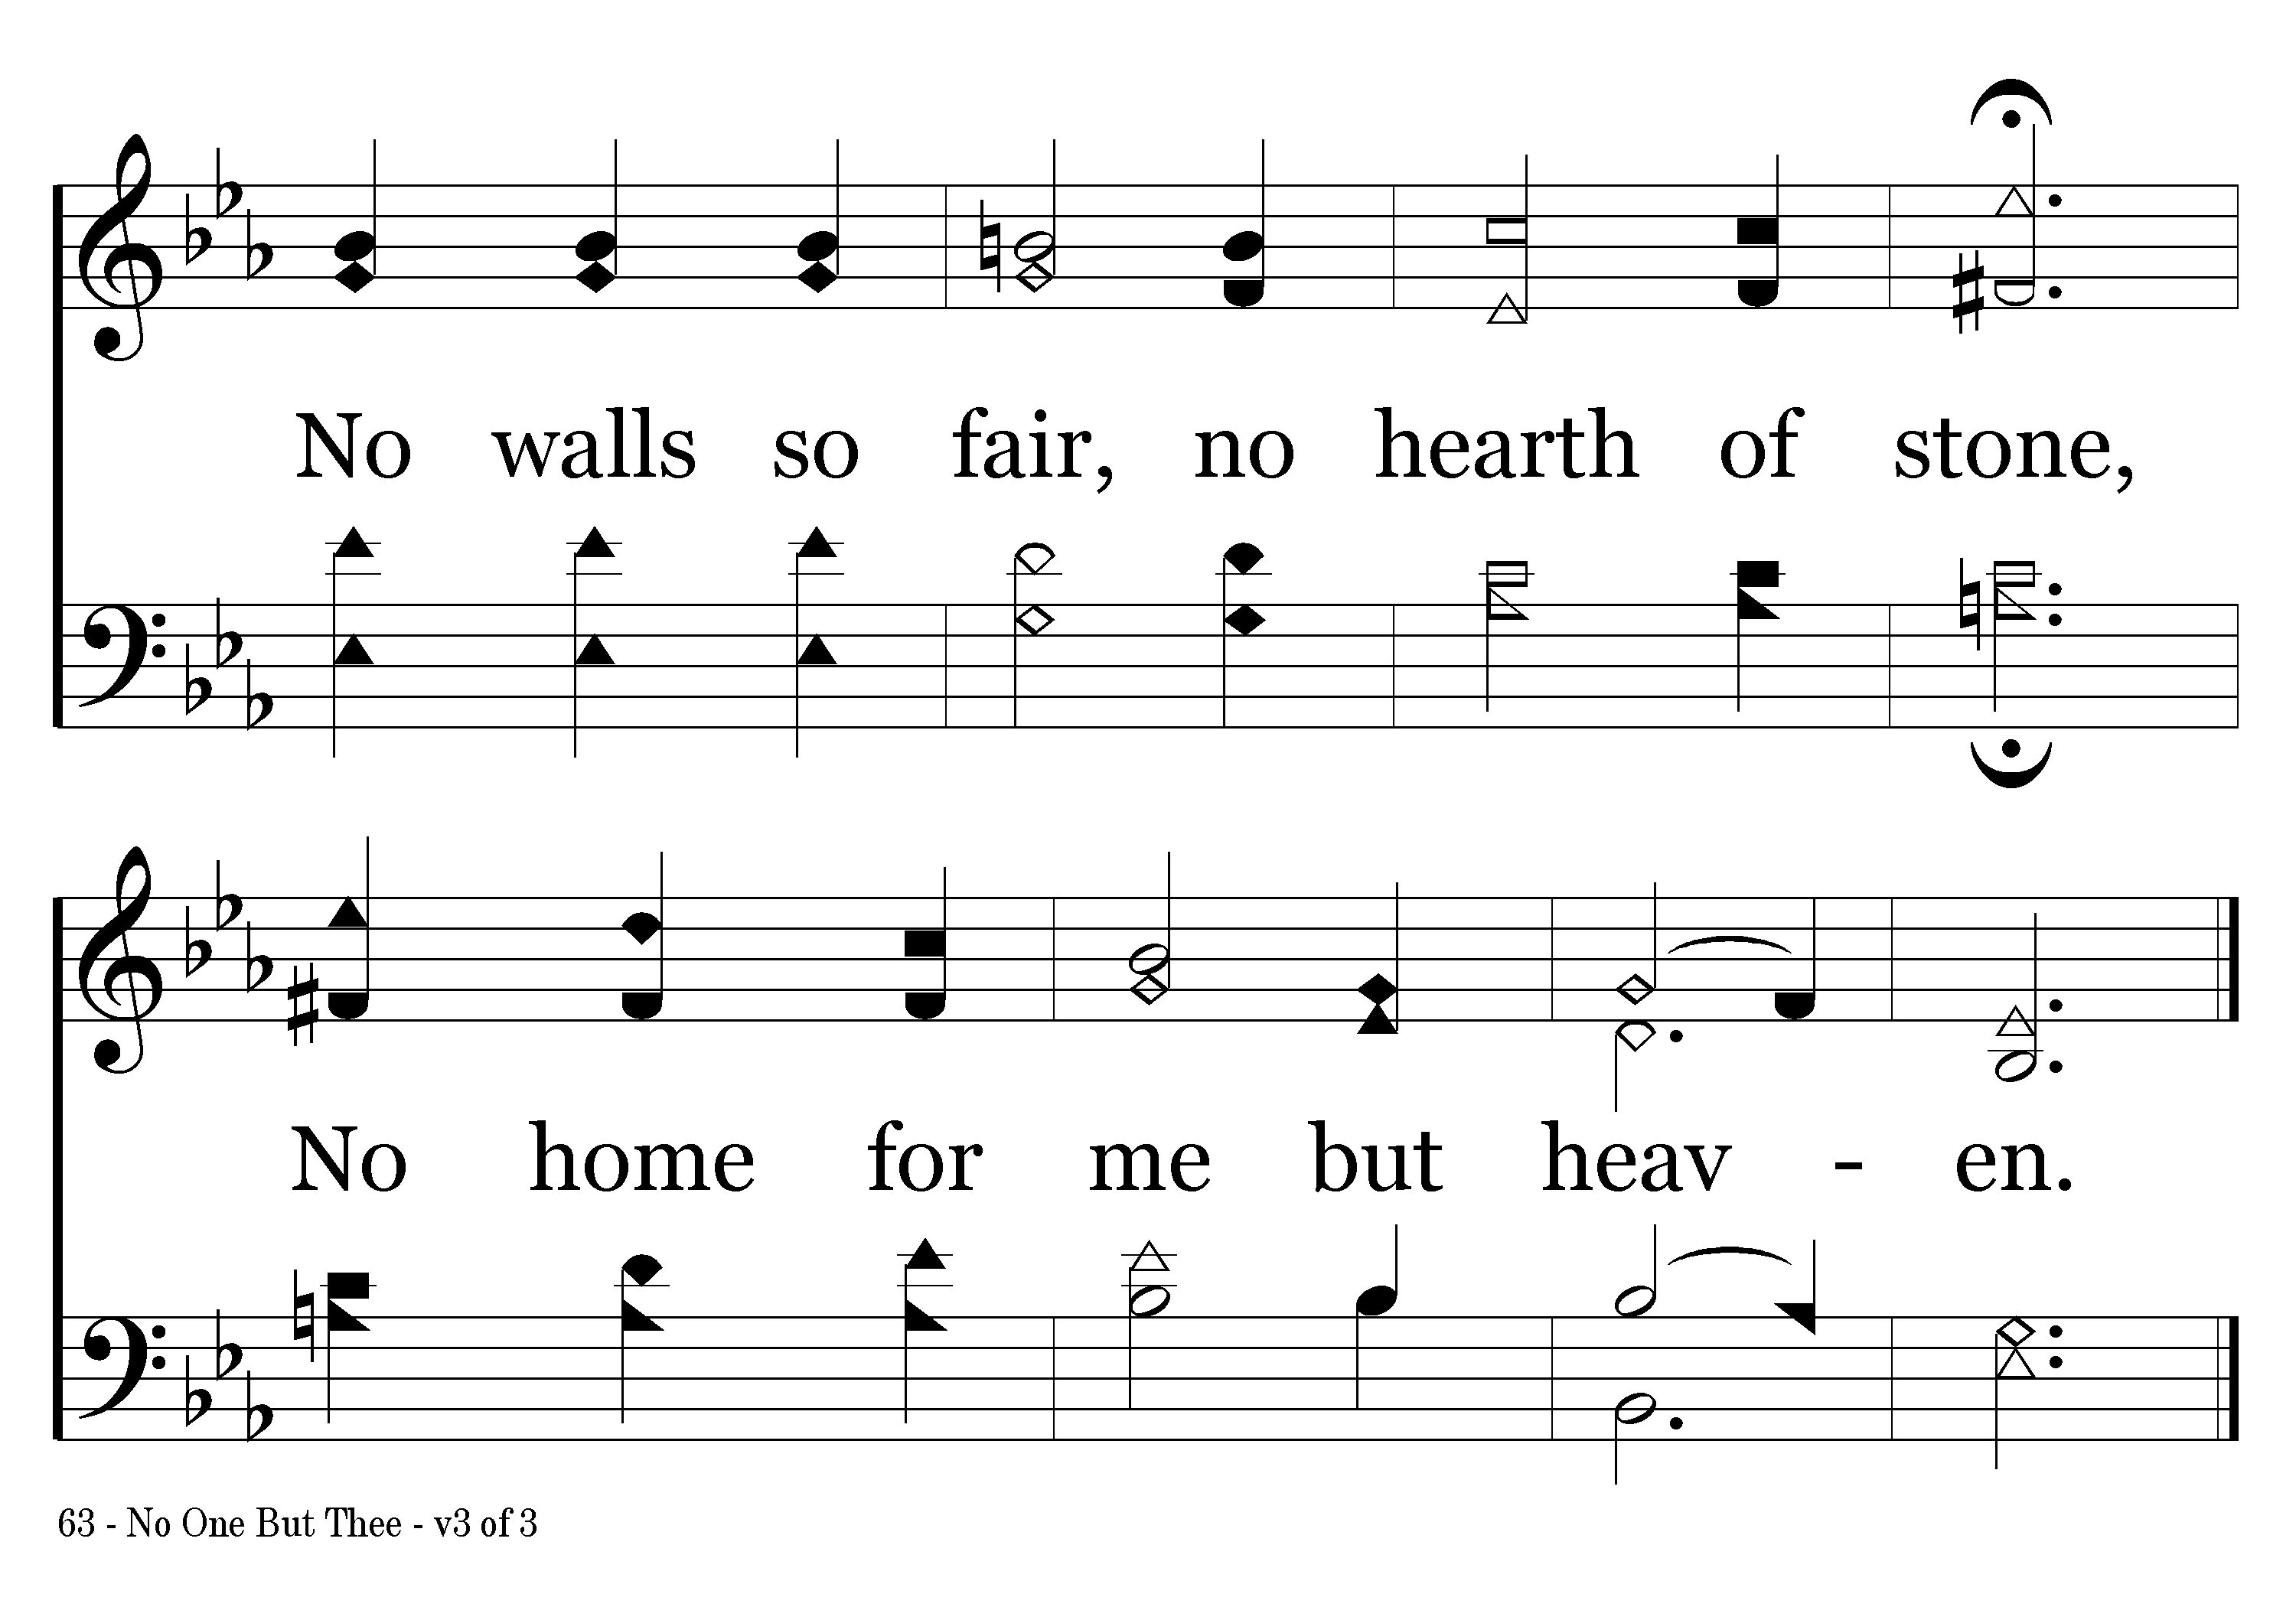
063 - No One But Thee - 3.2
End of Song

